Slide 1

GMR Airports
A high performance airport platform
17th September, 2019

Slide 2

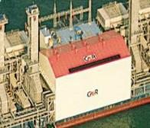


GMR Group Infrastructure Portfolio
AIRPORTS
~275 Mn Total Passenger Capacity
~96 mn capacity operational, ~76 mn under development
Operational airports: Delhi and Hyderabad in India, Cebu in Philippines
Recent new wins – Goa & Nagpur in India, Crete in Greece, Clark (EPC) in Philippines
  Airport Land : ~230 acres in Delhi, ~1463 acres in Hyderabad, 232 acres in Goa, ~ 247 acres in Nagpur, ~ 400 acres in Greece, ~7 acres in Cebu
ENERGY
~6,800 MW Power Generation Capacity
Coal Based: 3,000 MW operational and 350 MW under development
Gas Based: 1,400 MW
Hydro Projects: 180 MW under construction & 1,800 MW under development¹
Solar: 25 MW & Wind: 3.4 MW
4 Coal Mines – 2 each in India and Indonesia²: Total reserves ~1020 Mn Tons
Transportation
Highways - 6 Operational Projects
4 Annuity Projects – 285 kms & 2 Toll Projects – 216 kms
Railways
Construction of 417 Km stretch in Eastern DFCC
URBAN INFRASTRUCTURE
~13,000 Acres Land
  10,400 acres in Kakinada (AP) & ~2,500 acres (acquired) in Krishnagiri (TN)
¹ Includes 600 MW of Upper Marsyangdi which is under divestment process (agreement signed)
² One of the Indonesian mines is under divestment process

Slide 3



Driven by Group’s Passion, Patience & Perseverance, we have come a long way & aspire to be the best
2020+
Large & diversified infrastructure player
Creating Tomorrow, Today
2019
8+ Airports
4 Highways
2 Special Investment Regions
9 Power Plants** / 2 Projects
1 Overseas Coal Block
GMR Group was established in
June 1978
Gaining momentum
7 Airports projects*
6 Highways
2 Special Investment Regions
8 Power Plants** / 3 Projects
2 Domestic Coal Blocks
1 Overseas Coal Block
1996
Entry into Infrastructure
200 MW IPP in Chennai
*Includes Nagpur International Airport
**includes Minority stake in GCEL and GREL
Notes:
Energy
Projects – 4 hydro, Chhattisgarh, GREL.

Slide 4
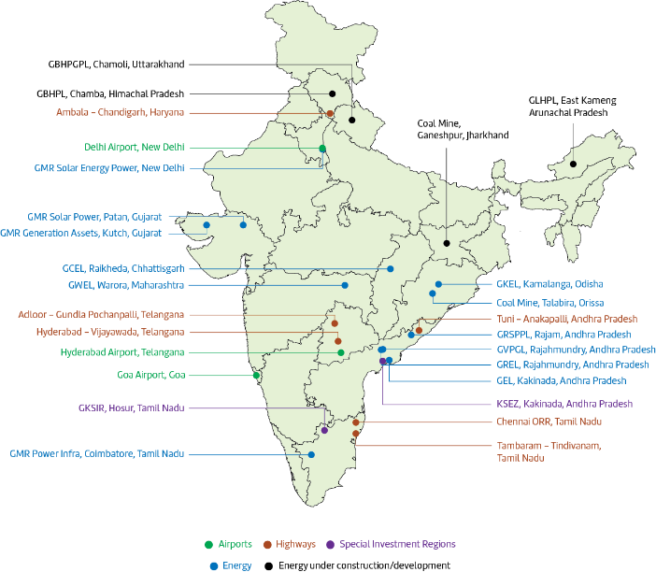
Our projects are located across the country...
Nagpur Airport, Nagpur

Slide 5
... as well as internationally.
5 International locations
Crete International Airport
35 yr Concession
Eventual capacity ~ 15 Mn
Hydro portfolio (900 MW)
Upper Karnali
Clark Airport
-EPC and O&M Contract
Cebu Airport
25 yr Concession
Eventual capacity ~ 27 Mn
Legend
Golden Energy Mines- 2.4 bT resources
Airport
Energy Projects

Slide 6
Key Financial Indicators over the years
* FY17 onwards nos.are as per Ind AS while previous nos. are as per IGAAP

Slide 7
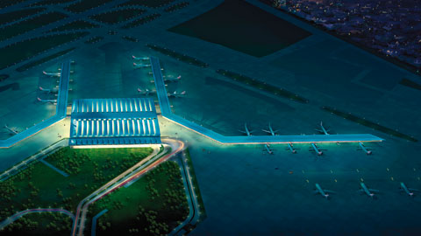
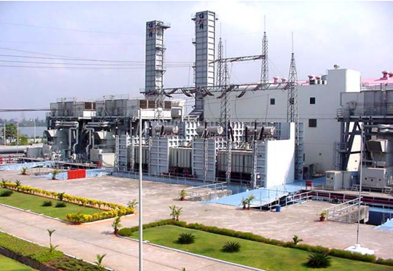
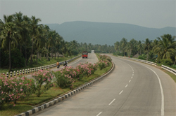
Group has significant, and in many cases first, achievements across the infrastructure sector
5th largest private airport developer in the world
Developed the first PPP Airport in India @ Hyderabad
First Indian Private Company to Venture into the Airports Business
First Indian company to expand its airports business globally
Among the leading Energy Producers in the Country
World’s largest barge mounted 220 MW combined cycle power plant
World’s largest 2 stroke diesel engine driven electric power plant
Among Top 3 Highway Developers in India
First Highway project in India under the Build, Operate and Transfer Model

Slide 8
In today’s globalized world, Airports have become the economic engines …
Socio - economic benefits
The impact of Airports and Civil Aviation has several dimensions across the economy
While air transportation is relatively expensive, it is also the most practical way of covering long distances within a reasonable time frame
Airports are a complex and technology-intensive industry, requiring a variety of inputs and skilled labour for its operations
Additionally, Airports spawn new industries not only associated with its backward linkages but also those which critically require air transportation, such as the export of perishable and high-value products
Employment
GDP contribution (direct & indirect)
Tax
Basis our experience, we believe Airports have an output multiplicative effect of 3x – 4x through its inter-industry linkages.

Slide 9
… and spawn many different businesses in their folds.
IT
……
Illustrative
……
Airlines
Customs
Engineering & Ops
Govt. agencies
Airlines & Cargo
Cargo operators
Security
Airport
….
Suppliers
Construction
Retail & Commercial
Suppliers
Builders
Concessionaires
…..
Real Estate
Services
Airports foster creation of a multiplicative and complex ecosystem across various aspects of its life-cycle.

Slide 10
In our view, multiple aspects need to come together to build a world-class and successful airport portfolio.
Customer Experience
Enhancing user convenience and comfort
Fund Raising
Balancing the risk-reward equation
Revenue Enhancement
Creating a positive cycle of self-sustaining economic momentum
Operational Excellence
Focus on service quality and safety
Project Delivery
Ensuring all the pieces fit together seamlessly
GMR has demonstrated deep expertise and capability across all these aspects.

Slide 11






We Have Built a Comprehensive Suite of Capabilities
EPC
Airport
Operations
Non-Aero
Expertise
RE
Development
Advisory and Consulting
How We Got Here: A Journey of Constantly Expanding Our Capability-Set across Multiple Geographies and Airports
2018
Goa Airport
(Concession Won;
Expected COD in 2020)
2016–2017
Crete Airport
(Concession Won
Expected COD in 2023)
2015
2014
Nagpur Airport*
(Bid Won in
in Sep 2018)
Bhogapuram Airport
Clark Airport
(EPC)
2010
2008
2006
2004
Cebu Airport
(Concession Won and Operations Commenced)
Oman Airport
(Advisory Work)
Istanbul Airport
(Operations Commenced;
Divested in 2014)
Male Airport
(Operations Commenced;
Exited in 2012)
Hyderabad Airport
(Concession Won;
Operations commenced in 2008
)
Delhi Airport
(Concession won; Operations commenced in 2006)
Existing Concessions
Past Concessions
Asset Light Contracts

Slide 12








Our 6 World Class Airports: A Snapshot
Current PAX (FY18)
(mm)
Marquee asset of national importance
Gateway to India — Catering to one of the largest urban conglomerates in the world
Ranked 1st in the world by ACI³ in 40 mm+ category competing with Incheon (South Korea), Changi (Singapore) in 2017 ASQ awards
DIAL, New Delhi, India
Vital international gateway to Philippines
2nd busiest and fastest growing airport in Philippines
Named “APAC Regional Airport of the year” by CAPA³ in November 2016
PAX CAGR
FY13–18
66
Cebu, Philippines
Cargo CAGR
FY13–18
14%
10
Current / Max Capacity
(MPPA)⁵
9.3%
64 / 119
15.8¹/28.3
Revenue Share
(%)
45.99%
GAL Stake
(%)
64.0%
40.0%
Nagpur, India
Crete
DIAL
Winter capital of Maharashtra
fast emerging as a major IT/ITES, logistics, and aerospace hub along with a major manufacturing base
Important Tourist Gateway
New airport with higher capacity replacing 2nd largest airport in Greece currently serving 6.9mm passengers
Crete, Greece
2.19
1.9 / 4⁶
MOPA
GHIAL
15²
11.6%
5.76%
CEBU
11
21.6%
8.6%
99.99%
Ranked 1st by ACI^{3,4} in its ASQ awards for 2017
Fastest growing major Indian airport by traffic
Poised to become regional hub
Goa is India’s leading international tourist destination
Tourist airport with high international passenger traffic and non-aero potential
GHIAL, Hyderabad, India
MOPA, Goa, India
7.7² /33
18.2
12 / 80
36.99%
17%
4.0%
99.99%
9.5%
63.0%

Slide 13
…and currently figures amongst the top 5 private airport developers in the world…
No. of Airports
(Operational)
35
14
4
3
5
All figures for CY 2017¹
PAX (MPPA)
2
3
Geography
France
Asia
S.America
Turkey
Georgia
Tunisia
Macedoni
Saudi Arabia
UK
Europe
S.America
India
Philippines
Europe
Type of Interest
Developer
+
Operator
Developer
+
Operator
Operator
Developer
+
Operator
Investor/
Operator
Key Airports
Kansai
Lisbon
Santiago
Porto
Faro
Nantes Atlantique
Istanbul
Ankara
Izmir
Riga
Madinah
Heathrow
Glasgow
Aberdeen
Southampton
Delhi
Hyderabad
Cebu-Mactan
Dusseldorf
Athens
Hamburg
Budapest
Recently won greenfield assets Goa and Greece (Kasteli) will be added to the portfolio in next 3-4 years
Note:
Based on available data for CY2017
46% Owned by AdP
UK assets of Glasgow, Aberdeen and Southampton are in a 50:50 consortium with Macquarie fund

Slide 14

GMR Airports has proven its business development capabilities across diverse situations…
India
International
Delhi
Hyderabad
Goa Mopa
Mactan-Cebu
Heraklion
Istanbul
Male
Clark
Country | India |  |  | Philippines | Greece | Turkey | Maldives | Philippines
Airport development | Brownfield expansion | Greenfield development | Greenfield development | Brownfield development | Greenfield development | Brownfield development | Brownfield expansion | Brownfield expansion
Regulatory Mechanism | Hybrid Till | Hybrid Till | Hybrid Till | Fixed Aero Tariffs | Fixed Aero Tariffs* | Fixed Aero Tariffs | Fixed Aero Tariffs | EPC Bid
Bidding Process | Sealed Auction | Swiss Challenge | Sealed Auction | Sealed Auction | Sealed Auction | Open Auction | Sealed Auction
Bid Parameter | Revenue Share | Financial Grant | Revenue Share | Upfront Premium | Complex Financial Bid | Upfront Premium | Complex Financial Bid
Dual airport system | No | No | Yes | No | No | Yes | No | Yes
Traffic profile | Business + Tourist | Business | Tourist | Business + Tourist | Tourist | Tourist | Tourist | Business + Tourist
Climate | Temperate | Equatorial | Equatorial | Equatorial | Equitorial | Temperate | Equatorial | Equatorial
*Malé Airport concession declared void by GoM – a politically motivated decision
*Istanbul: GMR divested its stake in early 2014
GMR Airports has successfully participated and won bids under different regulatory framework, bidding processes and complex financial bid parameters underscoring its deep understanding of airport business
* First 3 years are dual till; post that fixed tariff

Slide 15







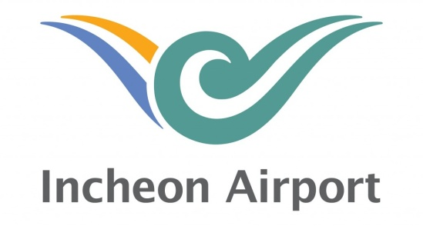
…and has won airport bids against the biggest players to establish its positioning.
Successful Bids
Hyderabad (India)
Delhi (India)
Male (Maldives)
ISG – Istanbul (Turkey)
Cebu (Philippines)
Goa (India)
Kastelli (Greece)

Slide 16
Today, GMR has developed a strong presence across the entire aviation value chain….
Airport development, construction, consulting
Maintenance, repair and overhaul (MRO)
Duty free, food and beverage, advertising etc.
Airport business development
Cargo, ground handling etc.
Airport & Aviation Training
Asset
Airport O&M
GMR Airports
Delhi Airport
Hyderabad Airport
GMR Airport Developers
Training
Business development
Development and construction
Airport Operations
Commercial
    Experienced business development team
    Successfully bid to develop six airports across three continents
    Developed new terminal at Istanbul Sabiha Gökçen Airport 12 months ahead of schedule
    Developed Delhi Terminal 3 in record time of 37 months
    Currently constructing a new terminal & allied facilities at Mactan-Cebu Airport
    End to end operation and management of airports
    Currently operating Delhi, Hyderabad and Cebu airports
    Delhi is the largest airport in India
    Significant commercial operations across airports portfolio
    Delhi Duty Free is India’s largest airport retail offering
    Commercial operations at Delhi and Hyderabad through JV agreements and subsidiaries
    Centre of Excellence for training & development of world class aviation professionals
    Training through GMR Aviation Academy, APFT GMR (flight training school) and GMR Airport Developers (airport operations)
Additionally, GMR’s Airports are consistently ranked amongst the best, in their respective categories, from a customer service perspective.

Slide 17






















…and has leveraged its platform to develop deep relationships with its partners across the value chain.
Business
Partners
Airport
Duty Free
Advertising
MLCP | Greenwich
IT
F&B
Fuel
Cargo
Aviation Services
MRO
GMR has leveraged the expertise of its partners to create profitable assets and has in the process developed lasting relationships across the airport space.

Slide 18
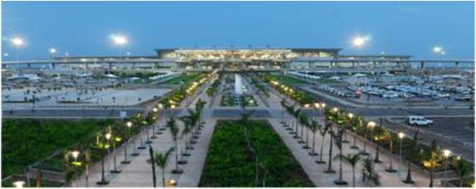
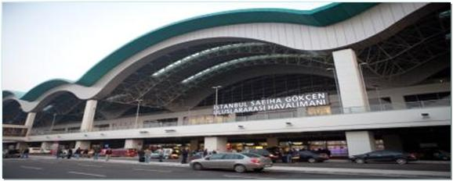
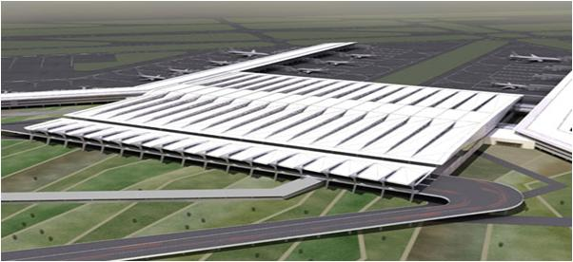
GMR has created and has broken many industry records for its airport assets…
India’s first Greenfield airport project – completed before time
Total capacity of 12 MPPA
RGIA, Hyderabad
Super-fast project execution in 18-months
Capacity of 20 MPPA
SGIA, Turkey¹
Among largest terminals globally
Completed in record 37 months
Total capacity of 60 MPPA
IGIA, Delhi
1. GMR Divested its stake in SGIA in Mar’14

Slide 19
Delhi Airport is our marquee example of airport development as well as operation capabilities.
Airport | Capacity (mppa) | Floor (Sqm) | Construction (Months)
London Heathrow T5 | 28 | 353,000 | 72
Madrid | 42 | 757,000 | 70
Bangkok | 45 | 563,000 | 60
Kuala Lumpur | 25 | 479,000 | 54
Beijing | 43 | 900,000 | 52
Delhi T3 | 34 | 54,000 | 37
Delhi T3, one of the largest terminals in the world, was completed in record time compared to benchmarks.¹
2017
No. 1 Airport globally in >40 MMPA category
2014
ASQ – 4.99/5
Rank – 1/ >200
2013
ASQ – 4.90/5
Rank – 5 / >200
We turned around operations, transforming it from one of the worst to one of the best in the world.
2011
2009
ASQ – 4.84 / 5
Rank – 4 / >200
ASQ – 4.73 / 5
Rank – 6 / 179
2007
ASQ – 4.16 / 5
Rank – 32 / 140
Source: Report by Jacobs Consultancy
ASQ – 3.02 / 5
Rank – 101 / 125
* Airport Service Quality ratings, which are standard third-party surveys conducted by Airports Council International to judge passenger service levels at participating airports

Slide 20
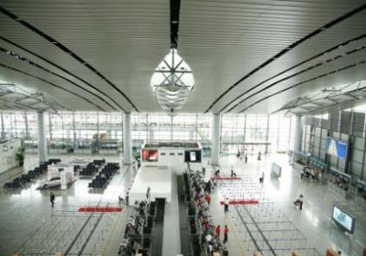
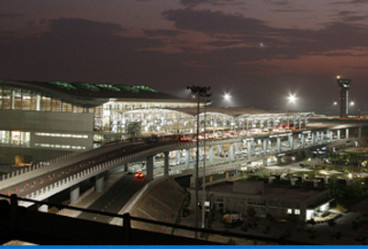


Hyderabad Airport, India’s first greenfield airport project is also among the best in the world.
We brought a lot of ‘Firsts’ to Indian Airports sector through the Hyderabad Airport Project…
Fully automated Airport Operations Control Centre (AOCC)
Among the tallest ATC tower (75 m) in India, tallest at that time
Longest taxiway (4395 m) & a Code F facility that is A380 Compatible
4 level inline baggage screening
…and delivered a world class airport…
42 aircraft parking stands - 12 boarding bridges
5 Star Airport Hotel
International Brands & Concessionaires
‘Slumber lounge’ with shower and nap facilities; Wi-Fi Access
…that is rated among the best in the world in its size category.
ASQ Ratings¹
Consistently among top 3 Airports in its Category
1
3
2
2
3
3
1
1
 | 2010 | 2011 | 2012 | 2013 | 2014 | 2015 | 2016 | 2017
On a scale of 5

Slide 21
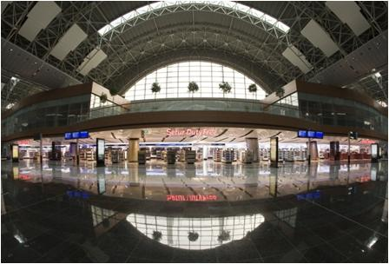
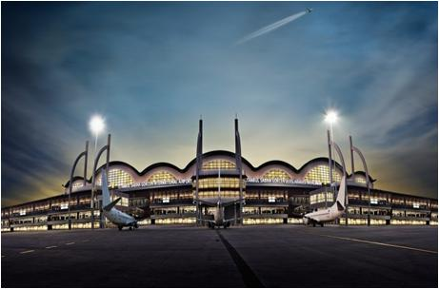
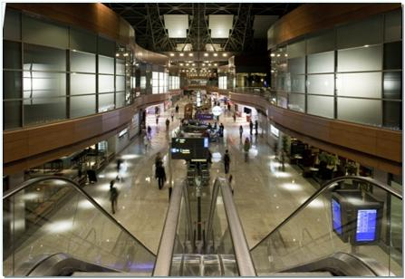
Sabiha Gokcen International Airport, Istanbul, Turkey was
GMR Airport’s first international project.
“Sabiha Gökçen was declared winner in its category
for highest traffic growth for two consecutive years”
“Received Best Airport Marketing Award in European region”
  First overseas project for GMR Group and any Indian airport developer
  Takeover in May’08 for a concession period of 20 years
  Total capital expenditure at Euro 451 Mn.
  Expansion from 5 Mn. passenger capacity to 25 Mn.
  Up-gradation of infrastructure to enhance Pax comfort & services
  New terminal inaugurated on 31st Oct. 2009
  Aprons 45 + 11 (Cargo) parking capacity for 44 planes and Cargo terminal of 7,950 sq.m
  GMR Divested its stake in early 2014

Slide 22
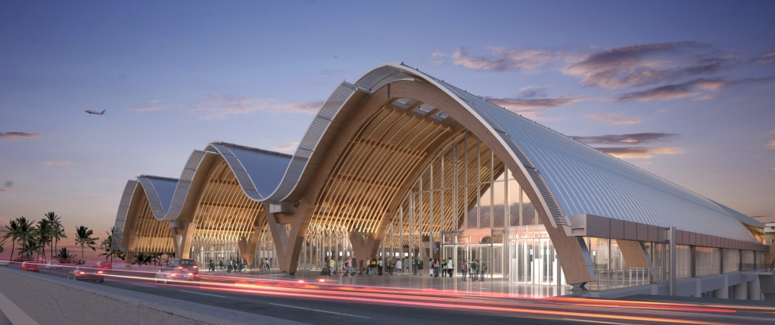
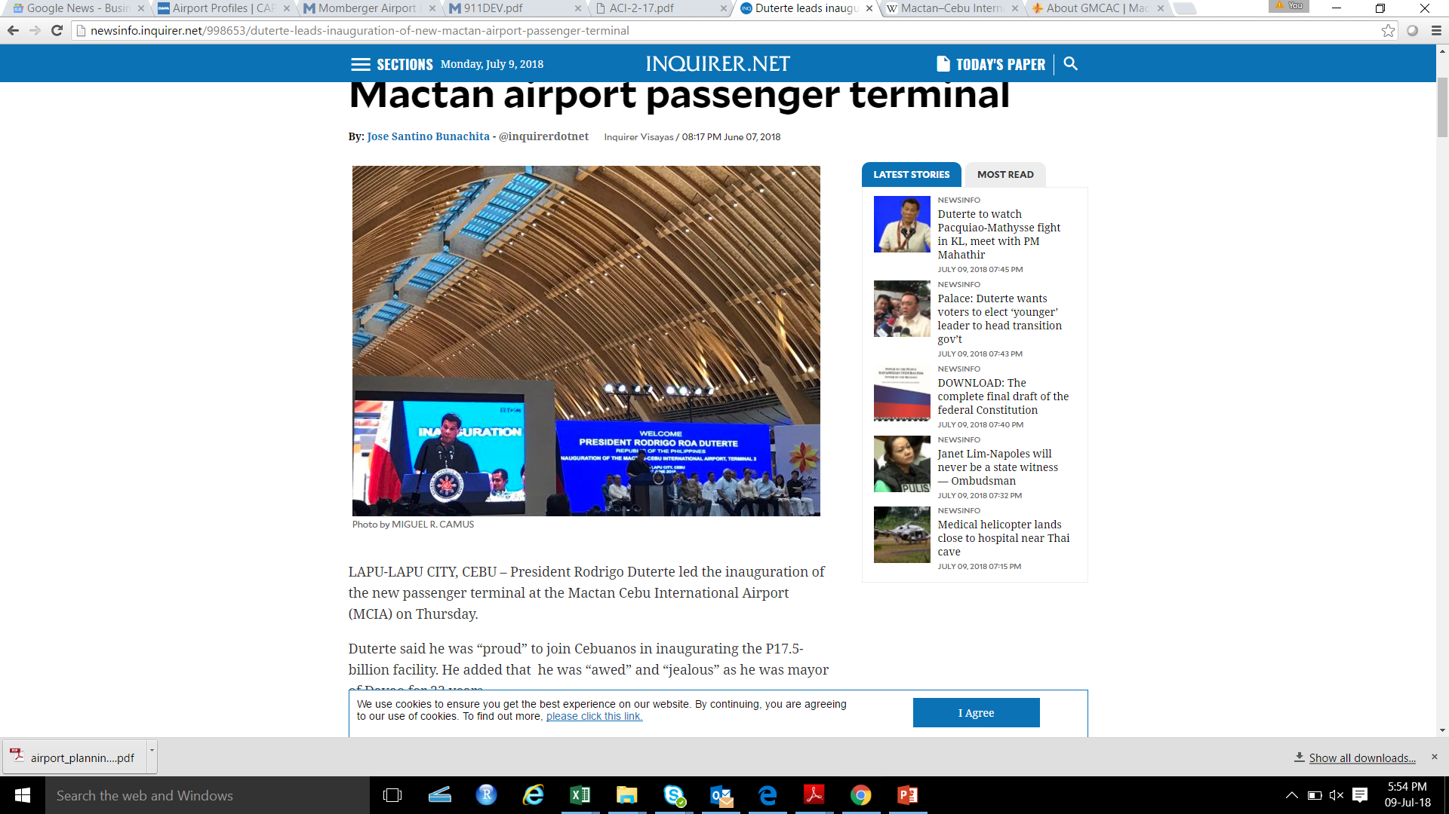
Philippines MCIA: A tourism gateway to the Philippines, the Mactan-Cebu airport is the 2nd busiest airport in the country
MCIA Terminal 2
The project involved construction of a new Terminal 2…
Terminal 2 opened for operations in July 2018
Total terminal area 43,398 sqm
Conceptualized as a resort terminal in line with Cebu’s positioning as resort island
Terminal roof is made of glulam (form of timber) keeping in view the Cebuano heritage of furniture making
MCIA’s T2 is the first airport building in Asia to use Glulam roof
With addition of Terminal 2, MCIA’s passenger handling capacity has increased to 12.5 MPPA
President Duterte inaugurated the Terminal
…and renovation of the existing Terminal 1
New floor area planned of ~7,800 sq.m. (total of 46,362 sq.m.)
MCIA has been witnessing double digit traffic growth
In 2017, passenger traffic grew @ 14% over 2016

Slide 23



Additionally, GMR Aviation Academy establishes GMR Airports positioning as an end-to-end aviation platform.
GMR Aviation Academy (GAA) is India’s premier aviation training hub
    Founded in 2009, GAA is India’s only aviation training centre approved by ICAO, IATA , ACI besides Indian Aviation Authority DGCA
    In 2014, ICAO certified it as a “Regional Centre of Excellence” – one among 3 training centres in Asia Pacific and 11 training centres globally
    GAA has a comprehensive course catalogue across Aviation competencies, Behavioural courses and E-learning modules
    Clients include all types of aviation players – airports, airlines, cargo operators, hospitality concerns, institutions from India, Asia-Pacific, Middle East and Africa
GAA has witnessed strong growth in reach
Number of Training Programs and Number of Participants (Yearly)
GAA has been certified by all global and domestic aviation governance bodies
GAA serves all major aviation players in India – airports, airlines, cargo and hotels
With a total participation of 25,000+ people across ~800 programs (in FY16), GMR Aviation Academy is India’s only ICAO approved Regional Training Centre of Excellence (RTCE).

Slide 24
To summarize, the takeaways from our unique experiences across different airport assets are as follows:
Bidding
Development
Construction
Commissioning
Operations & Commercial Enhancement
Different style and bidding motive
Greenfield development at GHIAL and Mopa
Revenue share at DIAL
Open auction at ISG
Complex financial bid at Male’ (Maldives) and Heraklion (Greece)
Government has a key role during development
High level of flexibility and innovation in Male’ and limited in DIAL
Fast-track of agreement required
Debt and other innovative project funding methods
Robust and detailed planning required
Local & on-ground understanding
Contracting strategy & construction methodology are key for project cost & time
Coordination with govt. agencies for clearances
Airlines shifting
Testing & trials of equipment & facilities
Readiness of stakeholders
Coordination with govt. agencies – Security, ATC etc.
Connectivity to airport
Public Advocacy
Operational & Commercial Turn-around at DIAL
Service quality delivery at GHIAL and DIAL
Attracting traffic in a competitive situation – ISG
Streamline operations to meet global practices and standards – Male’

Slide 25

Thank You

